Slide 1
Figures – Chapter 3

Slide 2
Figure 3.1 The principles of agile methods
Principle | Description
Customer involvement | Customers should be closely involved throughout the development process. Their role is provide and prioritize new system requirements and to evaluate the iterations of the system.
Incremental delivery | The software is developed in increments with the customer specifying the requirements to be included in each increment.
People not process | The skills of the development team should be recognized and exploited. Team members should be left to develop their own ways of working without prescriptive processes.
Embrace change | Expect the system requirements to change and so design the system to accommodate these changes.
Maintain simplicity | Focus on simplicity in both the software being developed and in the development process. Wherever possible, actively work to eliminate complexity from the system.

Slide 3
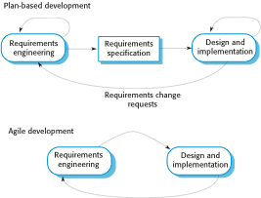
Figure 3.2 Plan-driven and agile specification

Slide 4
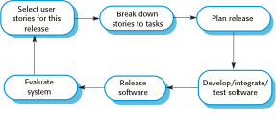
Figure 3.3 The extreme programming release cycle

Slide 5
Figure 3.4 Extreme programming practices (a)
Principle or practice | Description
Incremental planning | Requirements are recorded on story cards and the stories to be included in a release are determined by the time available and their relative priority. The developers break these stories into development ‘Tasks’. See Figures 3.5 and 3.6.
Small releases | The minimal useful set of functionality that provides business value is developed first. Releases of the system are frequent and incrementally add functionality to the first release.
Simple design | Enough design is carried out to meet the current requirements and no more.
Test-first development | An automated unit test framework is used to write tests for a new piece of functionality before that functionality itself is implemented.
Refactoring | All developers are expected to refactor the code continuously as soon as possible code improvements are found. This keeps the code simple and maintainable.

Slide 6
Figure 3.4 Extreme programming practices (b)
Pair programming | Developers work in pairs, checking each other’s work and providing the support to always do a good job.
Collective ownership | The pairs of developers work on all areas of the system, so that no islands of expertise develop and all the developers take responsibility for all of the code. Anyone can change anything.
Continuous integration | As soon as the work on a task is complete, it is integrated into the whole system. After any such integration, all the unit tests in the system must pass.
Sustainable pace | Large amounts of overtime are not considered acceptable as the net effect is often to reduce code quality and medium term productivity
On-site customer | A representative of the end-user of the system (the customer) should be available full time for the use of the XP team. In an extreme programming process, the customer is a member of the development team and is responsible for bringing system requirements to the team for implementation.

Slide 7
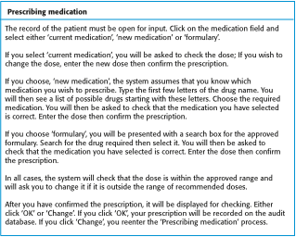
Figure 3.5 A ‘prescribing medication’ story

Slide 8
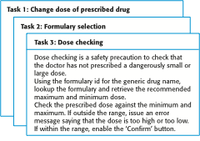
Figure 3.6 Examples of task cards for prescribing medication

Slide 9
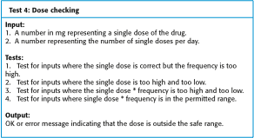
Figure 3. 7 Test case description for dose checking

Slide 10
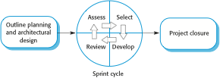
Figure 3.8 The Scrum process

